Slide 1
CHAPTER 4:
Virtual Environments
Designing the User Interface:
Strategies for Effective Human-Computer Interaction
Fifth Edition
Ben Shneiderman & Catherine Plaisant
in collaboration with
Maxine S. Cohen and Steven M. Jacobs

Slide 2
Virtual Reality
Virtual Reality is a high-end user-computer interface that involves real-time simulation and interaction through multiple sensory channels.
  Sensory information may include visual, auditory, haptic, tactile, smell, taste…
  Visual is dominating
Virtual reality can break physical laws and allow users to act as though they were somewhere else
6-<number>

Slide 3
Four Key Elements in Experiencing
Virtual Reality:
Virtual World
  An imaginary space, often (but not necessarily) manifested through a medium.
Immersion
  Having a sense of presence within an environment; this can be purely a mental state, or can be accomplished through physical means
  Mental immersion : A state of being deeply engaged, with a suspension of disbelief
  Physical immersion : Bodily entering a medium
Sensory feedback
  Visual/aural/haptic feedback to participants, based on some aspects of their physical positions
Interactivity
  In a virtual reality experience, participants are able to move around and change their viewpoint, generally through movements of their head.
6-<number>

Slide 4
Significance of Virtual reality in Flight Simulators
Flight simulation designers work hard to create the most realistic experience for fighter and airline pilots.
The cockpit displays and controls are taken from the same production line that creates the real ones.
Then the windows are replaced by high resolution computer displays and sounds are choreographed to give the impression of engine start or reverse thrust.
Finally the vibration and tilting during climbing or turning are created by hydraulic jacks and intricate suspension system.
6-<number>

Slide 5
Significance of Virtual reality in Flight Simulators (Cont..)
The elaborate technology may cost $100 million but even so, it is lot cheaper, safer, and more useful for training than the $400 million jet that it simulates.
Flying a plane is a complicated and specialized skill, but simulators are available for more common and some surprising tasks under the alluring name of virtual reality or more descriptive Virtual environments.
6-<number>

Slide 6
Types of VR Systems
Immersive VR (Artificial Reality)
Telepresence
Augmented reality
Desktop reality
6-<number>

Slide 7
Artificial reality and CAVE
Large screen projectors and video sensors combined full body movement with projected images of light creatures that walked along a performer’s arm or of multicolored patterns and sounds generated by the performer’s movement.
The CAVETM ( Cave Automatic Virtual Environment), a room with several walls of high resolution rear projected displays with three-dimensional audio.
Can offer satisfying experiences for several people at a time.
The theoretical possibilities have attracted researchers and media pioneers who are merging reality with virtuality.
6-<number>

Slide 8
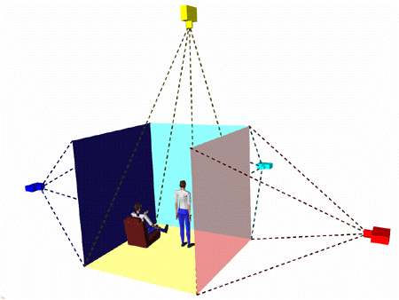
CAVE
6-<number>

Slide 9

CAVE – video
6-<number>

Slide 10
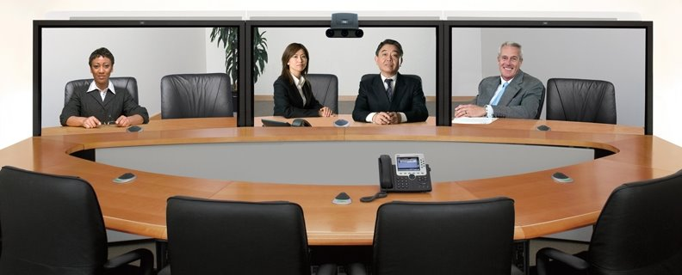
Telepresence
Telepresence aspect of virtual reality break the physical limitations of space and allows users to act as though they are somewhere else.
  Telepresence is a computer-generated environment consisting of interactive simulations and computer graphics in which a human experiences presence in a remote location.
CISCO Telepresence Board Room: (Online video)
http://video.cisco.com/#category/videos/industries
6-<number>

Slide 11
Augmented reality
Enables users to see the real world with an overlay of additional information.
Examples:
  while users are looking at the walls of a building, their semitransparent eyeglasses may show the location of electrical wires and studwork.
  Medical applications, such as allowing surgeons to look at a patient while they see an overlay of an x-ray or sonogram to help locate a cancer tumor.
6-<number>

Slide 12
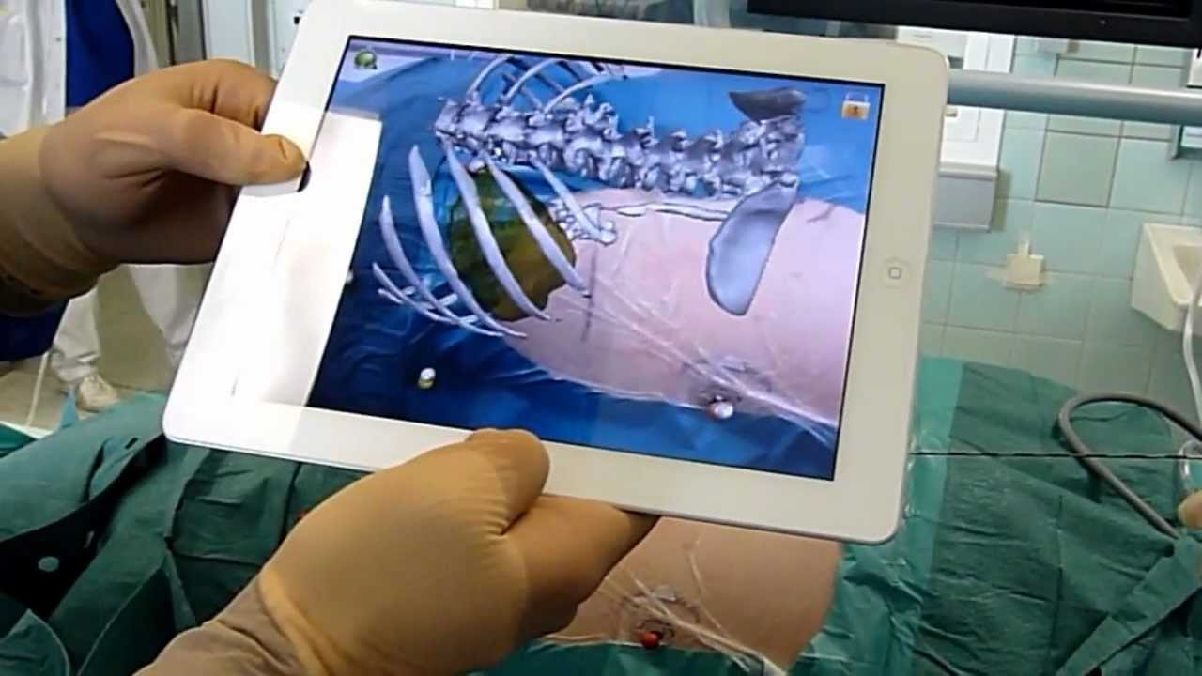
Augmented Reality – Medical Application
6-<number>

Slide 13
Desktop Virtual Reality:
Desktop or fish tank virtual environments (both references are to standard "looking-at" displays) are becoming more common, because they avoid the physically distressing symptoms and require only standard equipment.
Three-dimensional graphics have led to the development of user interfaces that support user-controlled exploration of real places, scientific visualizations, or fantasy worlds.
Many applications run on high performance workstations capable of rapid rendering, but some are appealing even over the Web, using VRML and its successors, such as X3D.
6-<number>

Slide 14
Technologies for
Successful virtual environments
  Visual Display
  Head position sensing
  Hand-position sensing
  Force feedback & Haptics
  Sound input and output
  Other sensations
  Cooperative and competitive virtual reality
6-<number>

Slide 15
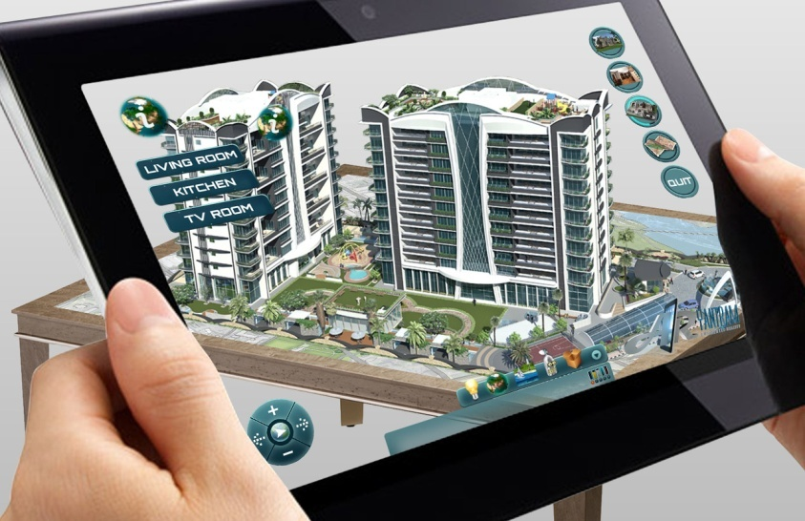
Technologies for
Successful virtual environments
1. Visual Display
Visual display. The normal-size (12 to 17 inches diagonally) computer display at a normal viewing distance (70 centimeters) subtends an angle of about 5 degrees; large-screen (17- to 30-inch) displays can cover a 20- to 30-degree field, and head-mounted displays cover 100 degrees horizontally and 60 degrees vertically.
The head-mounted displays block other images, so the effect is more dramatic, and head motion produces new images, so the users can get the impression of 360-degrce coverage. Flight simulators also block extraneous images, but they do so without forcing the users to wear sometimes-cumbersome head-mounted displays.
Another approach is a boom-mounted display that senses the users' positions without requiring them to wear heavy goggles
6-<number>

Slide 16
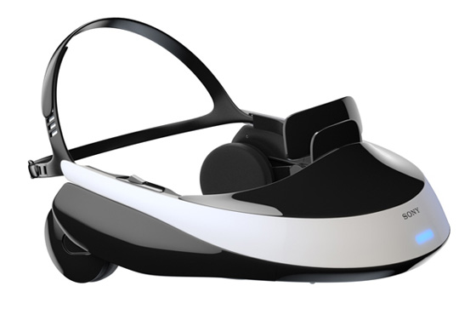
Technologies for
Successful virtual environments
2. Head Position sensing
Head-position sensing. Head-mounted displays can provide differing views depending on head position. Look to the right, and you see a forest; look to the left, and the forest gives way to a city.
Some head trackers can be cumbersome to wear, but smaller versions embedded in a hat or eyeglasses facilitate mobility. Video recognition of head position is possible.
Sensor precision should be high (within 1 degree and within 1centimeter) and rapid (within 100 milliseconds).
Eye tracking to recognize the focus of attention might be useful, but it is difficult to accomplish while the user is moving and is wearing a head-mounted display.
6-<number>

Slide 17
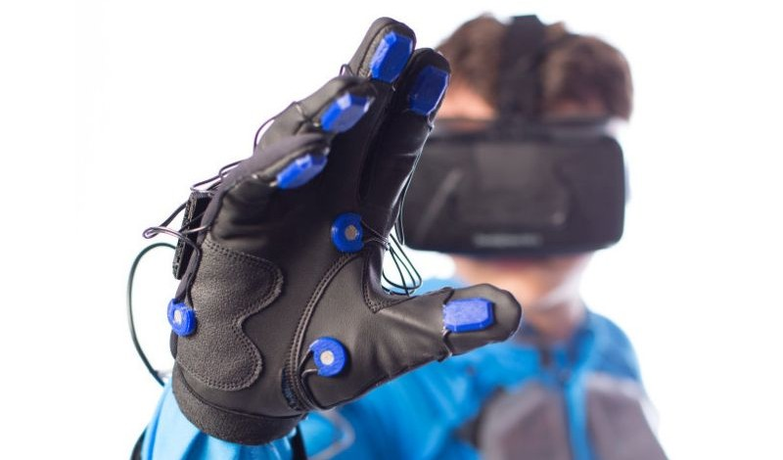
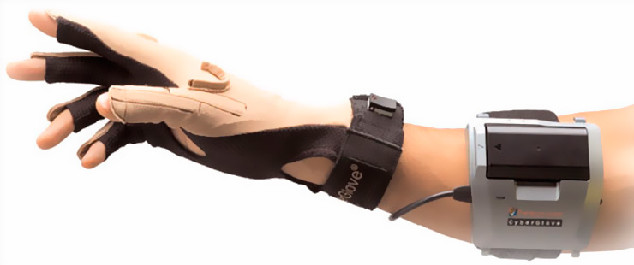
Technologies for
Successful virtual environments
3. Hand Position sensing
Hand-position sensing. The DataGlove™ is an innovative invention that continues to be refined, with improvements being made to its comfort, accuracy, and sampling rate.
The problems with glove devices include inaccuracies in measurement and lack of standard gestural vocabulary.
It may turn out that accurate measurement of finger position is required only for one or two fingers or even one or two joints.
6-<number>

Slide 18
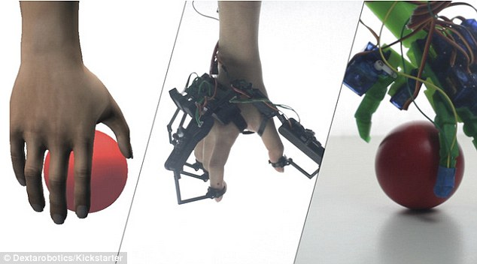
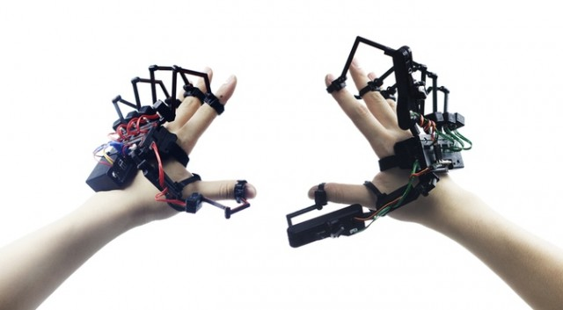
Technologies for
Successful virtual environments
4. Force feedback & Haptics
Hand-operated remote-control devices for performing experiments in chemistry laboratories or for handling nuclear materials provide force feedback that gives users a good sense of when they grasp an object or bump into one.
Force feedback to car drivers and pilots is carefully configured to provide realistic and useful tactile information. Simulated feedback from software was successful in speeding docking tasks with complex molecules.
Immersive Experience : (online video)
Humans Fly like a Bird:
http://www.sciencedaily.com/videos/39ace63e5be17764fd82ee48c6a33fee.htm
6-<number>

Slide 19

Technologies for
Successful virtual environments
5. Sound input & Output
Sound output adds realism to bouncing balls, beating hearts, or dropping vases, as videogame designers found out long ago.
6-<number>

Slide 20
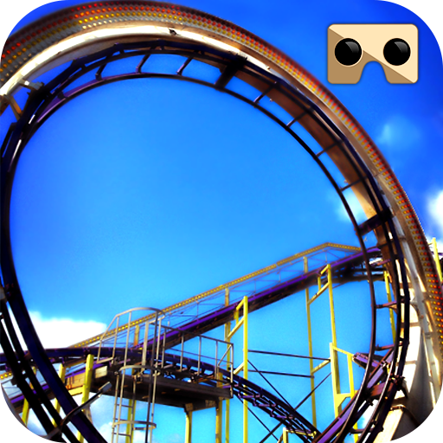
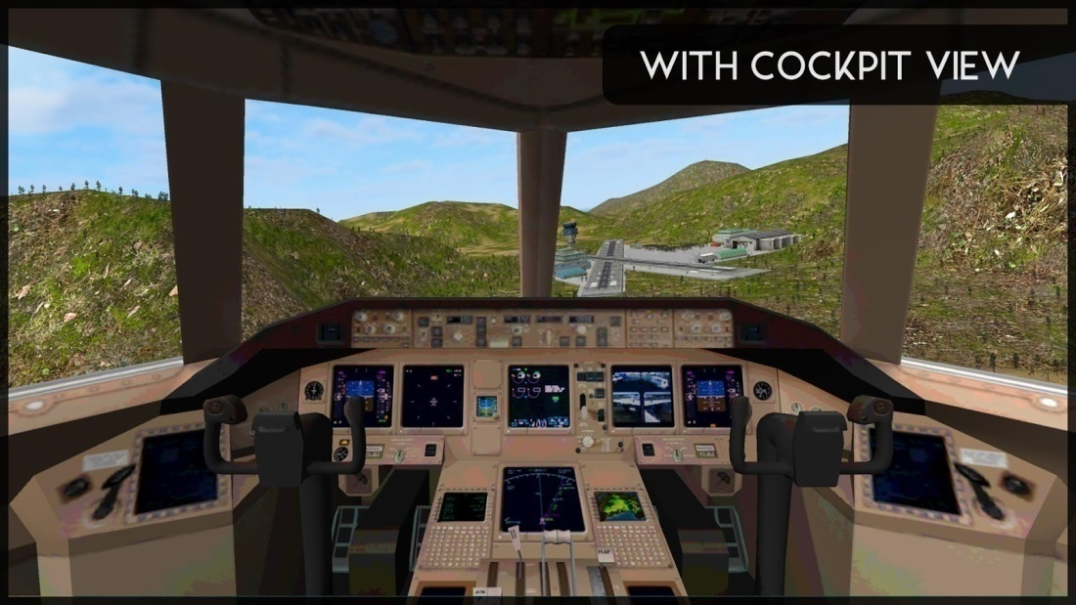
Technologies for
Successful virtual environments
6. Other sensations
The tilting and vibration of flight simulators
Tilting and Vibrating Virtual Roller Coaster
6-<number>

Slide 21
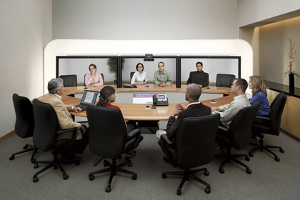
Technologies for
Successful virtual environments
6. Collaborative Virtual Environments
Such environments allow two people at remote sites to work together, possibly designing an object, while seeing each other's actions and the object of interest
6-<number>

